Slide 1
Basic Biological Concepts
Genetic Disorders
Section 2 – Lecture 3

Slide 2
Genetic Disorders
Genetic disorders are inherited (passed down to offspring) and are caused by a defect in the DNA which leads to improperly made proteins
You can’t “catch” a genetic disease by merely being around someone who has one.
Today’s lecture will cover genetic disorders that are:
Dominant Disorders
Recessive Disorders
X-linked Disorders
Chromosome Anomalies: wrong number
Single Gene Defects
Mitochondrial Defects
Multiple Gene-Environment Interactions

Slide 3
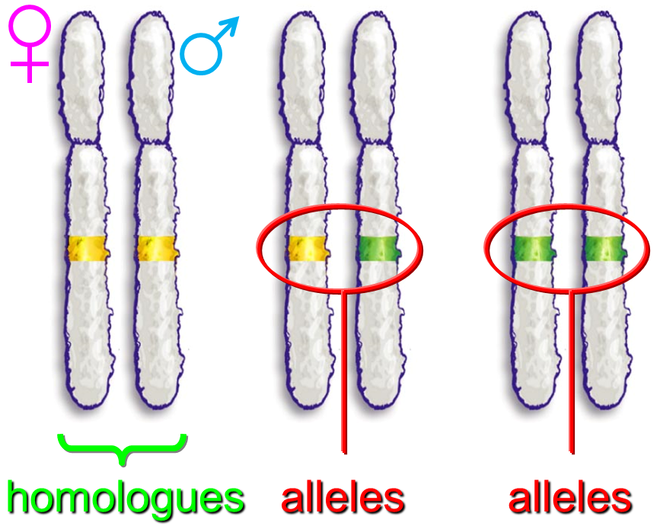
Dominant Disorders
A dominant genetic disorder occurs when the presence of a single defective allele causes a physiological problem
The effects of the defective allele mask the effects of the normal allele

Slide 4
Common dominant genetic disorders:
Polydactylism
Marfan syndrome
Huntington disease
If a person inherits an allele of a dominant genetic disorder, they will have the disorder
H = Huntington’s disease allele
h = normal allele
HH Hh hh
Has disease Has disease No disease

Slide 5
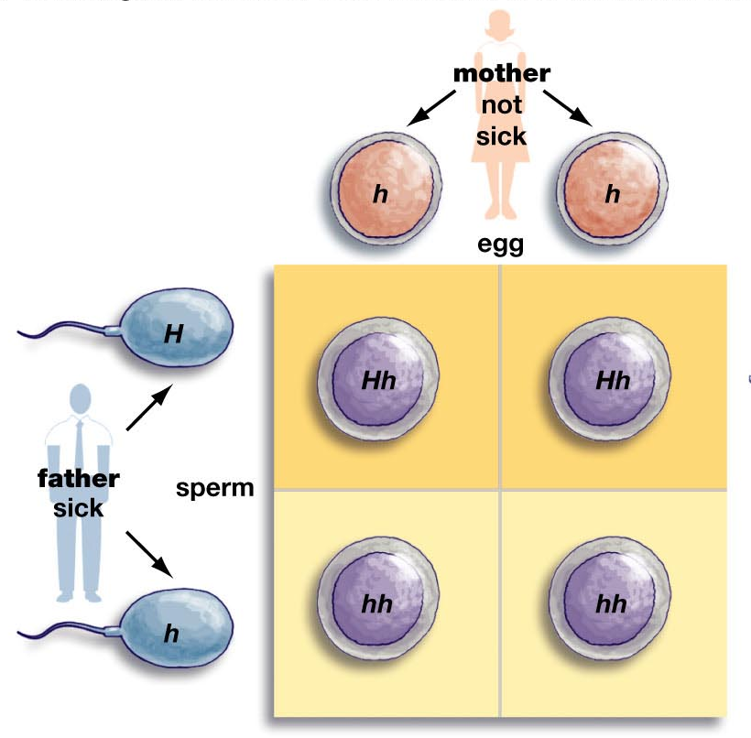
50% chance that a child would suffer from Huntington’s

Slide 6
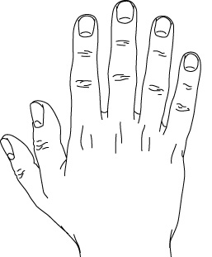
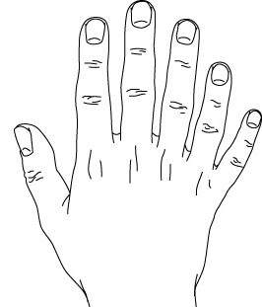
Polydactylism causes people to have extra digits on their hands and feet

Slide 7
Marfan Syndrome
Caused by a mutation of a gene coding for a protein found in connective tissue
Outward symptoms: tall, long limbs, long slender fingers
Other symptoms: problems with lungs, skeleton, heart valves, and eyes

Slide 8
Notable People with this disorder:
Flo Hyman – US Olympic volleyball player (died on the court)
Jonathan Larson – Wrote Rent (died 1 day before the opening of his musical)
Joey Ramone – Singer for the punk rock band the Ramones
Abraham Lincoln
Osama Bin Laden
Michael Phelps
Peter Mayhew (Chewbacca)
Sergei Rachmaninoff (composer)
Julius Caesar
Tutankhamun

Slide 9
Huntington's disease
Causes brain tissue degeneration
It is more common in people of Western European decent
It leads to problems in muscle coordination and cognitive functions

Slide 10
Recessive Disorders
Caused by a defective (mutated) allele
The effects can be masked by having the normal (non-defective) allele
Common recessive genetic disorders:
Albinism
Sickle-cell anemia
Cystic fibrosis

Slide 11
If a genetic disorder is caused by a recessive allele, a person must inherit two copies of the defective allele in order to have the disorder
Having just a single non-defective allele results in not having the disorder
A person that has one normal allele and one defective allele (heterozygous) for a recessive disorder is called a carrier
Carriers don’t show signs of the disease (it is masked) but can pass it down to their offspring
N = Normal allele n = Sickle-cell allele
NN Nn nn
No disease No disease Disease
(carrier)

Slide 12
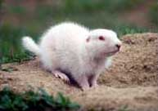
Albinism
A disorder in which the gene responsible for making the pigment melanin is defective

Slide 13
Cystic fibrosis
A disorder in which the gene for making a cell membrane chloride ion (Cl⁻) pump is defective
Symptoms: thick mucus, lung infections
Those afflicted live to their 20s - 30s

Slide 14

Sickle-cell anemia
A disorder in which the gene responsible for one type of hemoglobin is defective
More common in people of African decent
Those afflicted live to their 40s
The defective hemoglobin can cause red blood cells to collapse, changing from a biconcave into a sickle shape

Slide 15
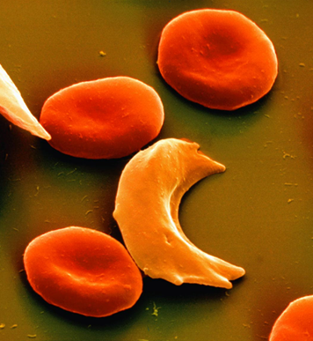
Sickle-shaped red blood cells can clog capillaries, preventing tissue “downstream” from getting blood
However, sickle-cell anemia provides a resistance to malaria (which is caused by a blood-borne parasite)

Slide 16
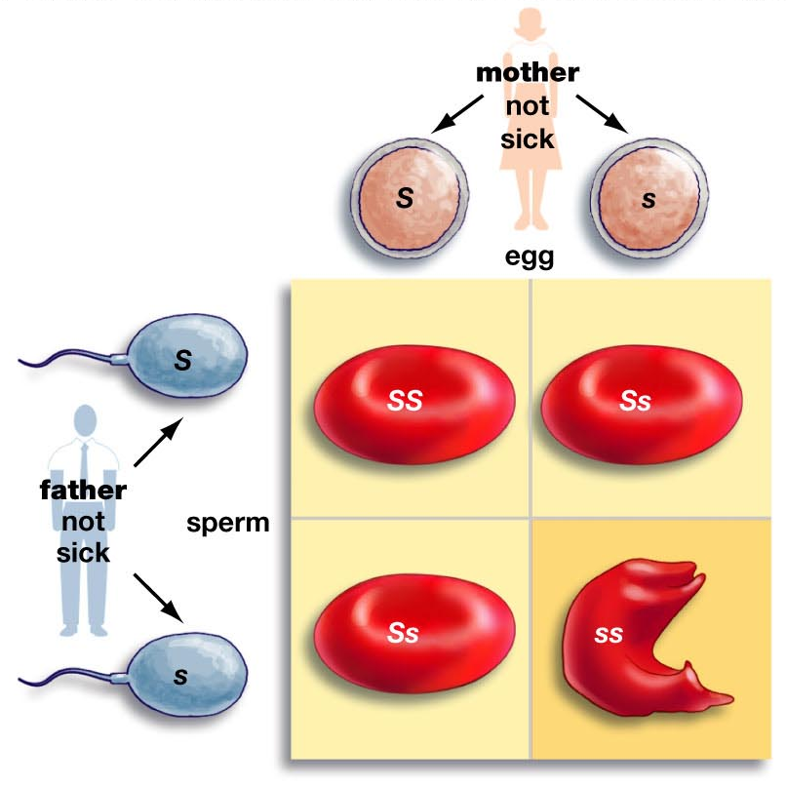
In the mating on the left, there is a 25% chance that a child would suffer from sickle-cell anemia but a 50% they would be a carrier

Slide 17
Dominant vs Recessive Disorders
Recessive genetic disorders are far more common than dominant ones
Why?

Slide 18
People with any genetic disorder (dominant or recessive) will pass down the genes for the disorder to their children
Compared to healthy individuals, people afflicted with genetic disorders (whether dominant or recessive) have lower probabilities of having children
One would think that because of this, genetic disorders would eventually be "weeded out" of the population.

Slide 19
Recessive disorders have carriers, with no symptoms they have the same probability of having children as anyone else
Carriers are not at a disadvantage for having kids and therefore keep the genes of the disorder in the population
Nearly all dominant genetic disorders do eventually get weeded out
Some domidon’t cause symptoms until later in life; after those afflicted have had children and passed the disorder down

Slide 20
X-linked Disorders
In humans there are 23 pairs of chromosomes
For 22 of the pairs, the homologues are indistinguishable from each other under the microscope
These 22 pairs of chromosomes are called autosomal chromosomes
For the sex chromosomes the homologues are very different as they determine sex and gender

Slide 21
The two versions of the sex chromosomes are called the “X” and the “Y” chromosomes
In humans, females have two X chromosomes (XX), while males have one X and one Y chromosome (XY)
X chromosomes contains more genes than Y chromosomes
Recessive genetic disorders found only on the X chromosome are called X-linked recessive disorders

Slide 22
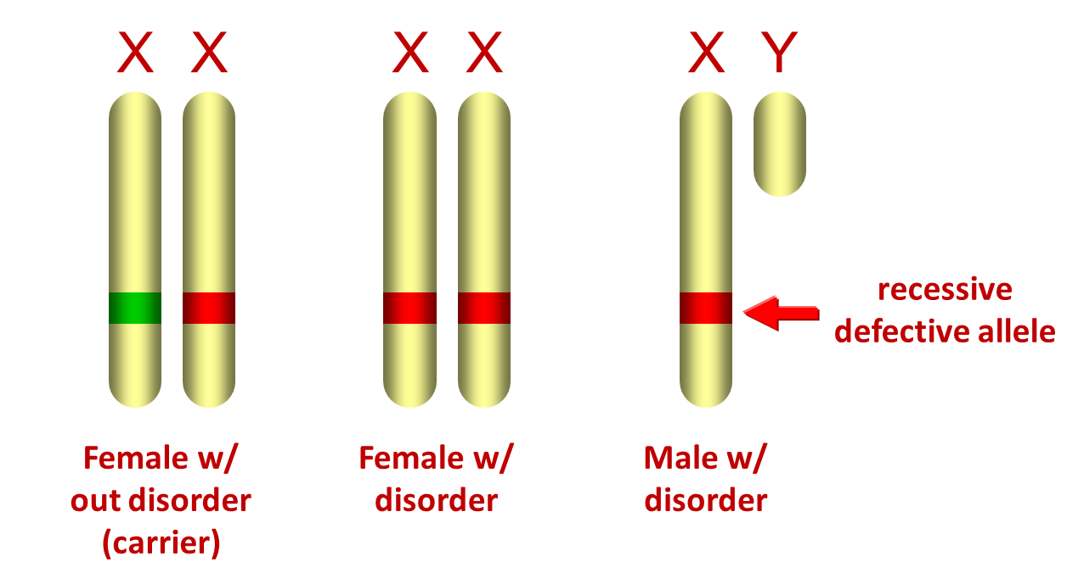
X
X
X
Y
X-linked disorders are less common in women because they have two X chromosomes (a backup copy)
X-linked disorders are far more common in men because they only have one copy of the X chromosome (no backup copy)
Normal allele
Female
(no disorder)
Male
(no disorder)
Women only show signs of an X-linked recessive disorder if they have two alleles for it
Men show signs of the disorder if they inherit only one allele for it (no backup to mask it)

Slide 23
Common recessive X-linked genetic disorders:
Hemophilia
Red-green color blindness
Hemophilia results from a defect in a gene responsible for making a protein necessary for blood clotting
Minor cuts can be life-threatening to a hemophiliac because they might bleed to death
Hemophilia is found with greater frequency in males of “royal blood lines”
Inbreeding of royal families ensured that the disorder was kept in the family tree (blood line) once it was introduced into it

Slide 24

Red-Green Color Blindness
There are three types of visual pigments used by our eyes to view the visual spectrum
Red-green color blindness results from a defect in a gene responsible for making one of the visual pigments
People with red-green color blindness still see color, but have difficulty perceiving red and green as separate colors
Top and bottom lights of a traffic light appear to be the same color

Slide 25
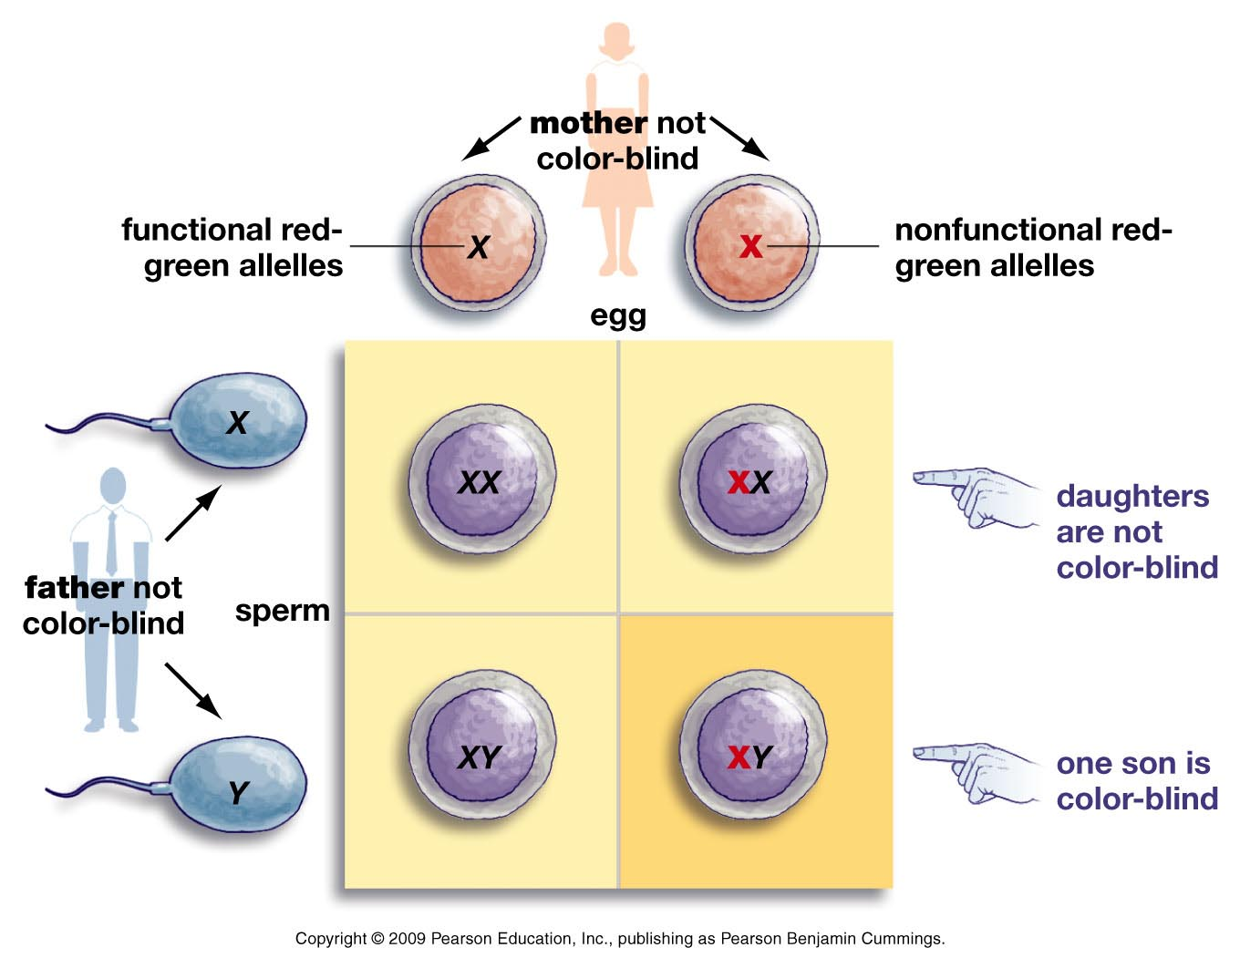

Slide 26
Chromosome Anomalies
Genetic disorders can also arise because of one of the gametes brings in more than one chromosome copy
Some people are born with 3 copies of an individual chromosome (which is known as trisomy)
Having 3 full copies of any chromosome is fatal except for chromosomes 13, 18, or 21
Trisomy disorders are named after which chromosome number has 3 copies
All trisomy disorders lead to physical and mental impairments

Slide 27
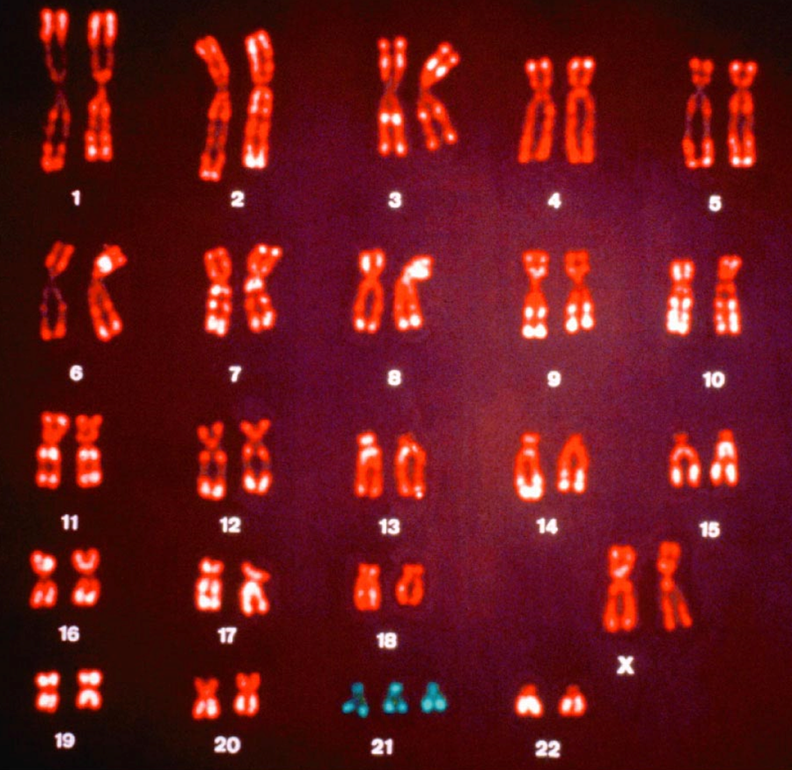
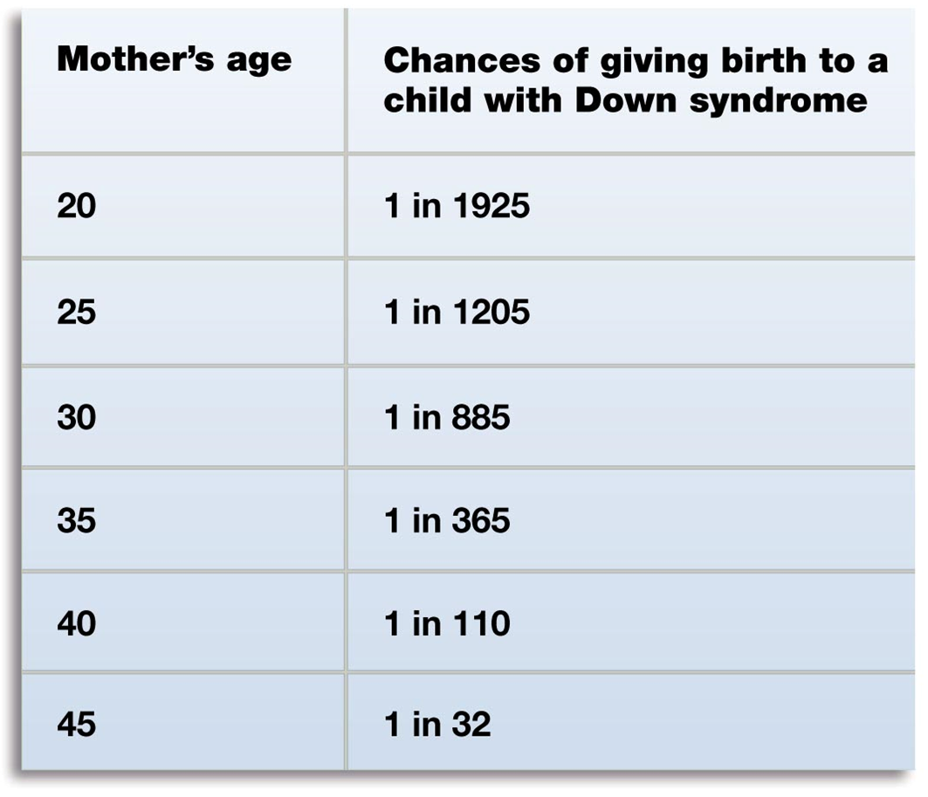
The most common form of trisomy is trisomy 21:
Known as Down syndrome
Symptoms: intellectual disability & impaired physical growth
Occurs ~1 per 1,000 births, but depends on mom’s age

Slide 28
90% of the time, trisomy is caused by non-disjunction
Non-disjunction is when chromosomes don’t separate during meiosis:
Anaphase I – homologues don’t separate
…or….
Anaphase II – sister chromatids don’t separate

Slide 29
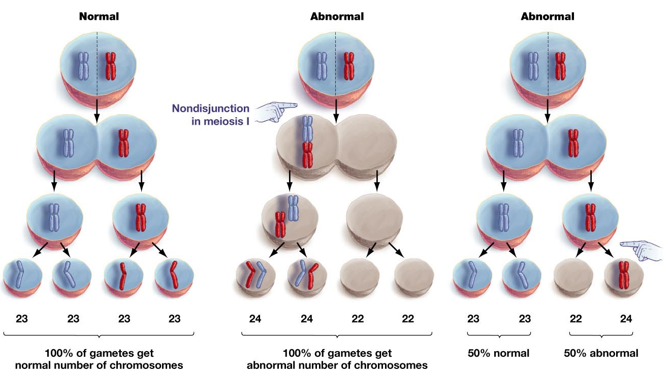
Non-disjunction

Slide 30
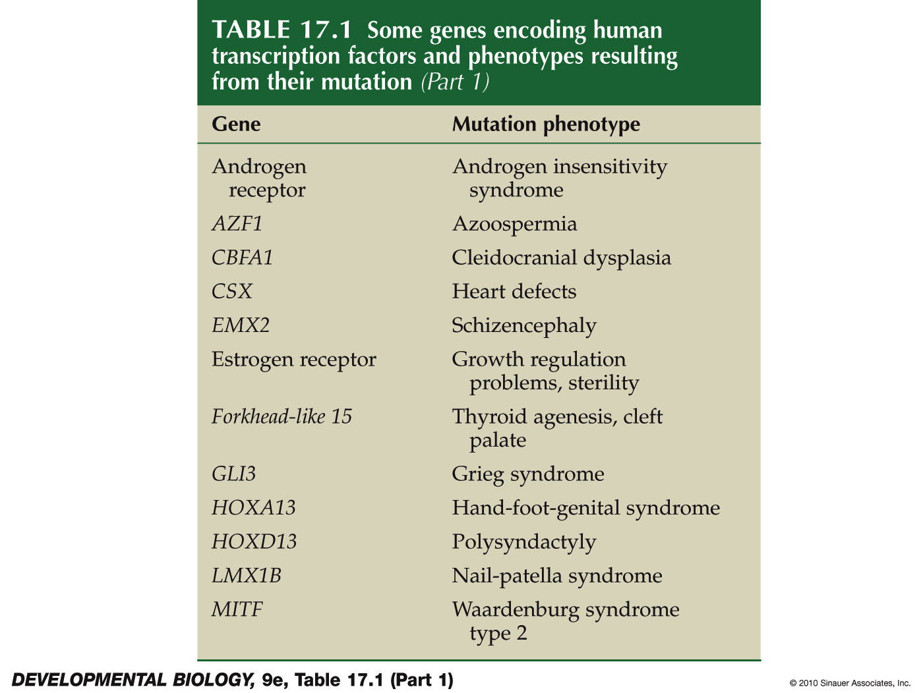
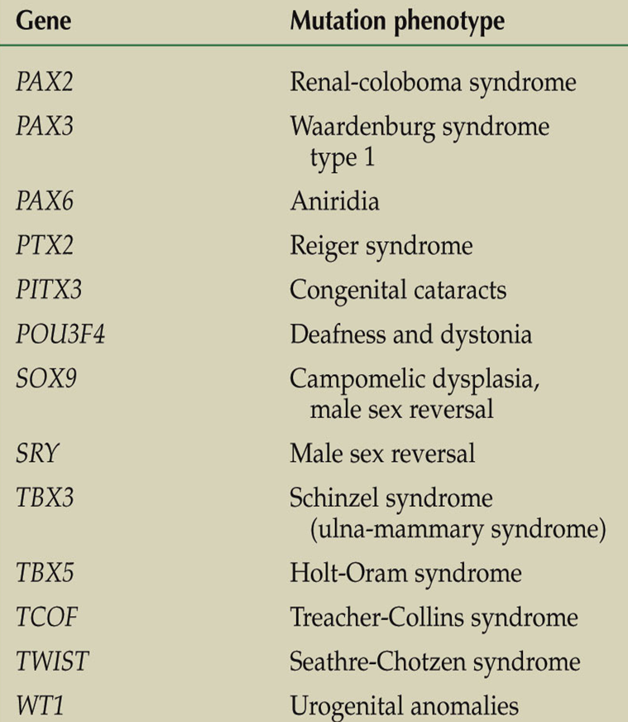
Lots of individual gene defects have been identified….
Notes:
DevBio9e-Table-17-01-1R.jpg

Slide 31
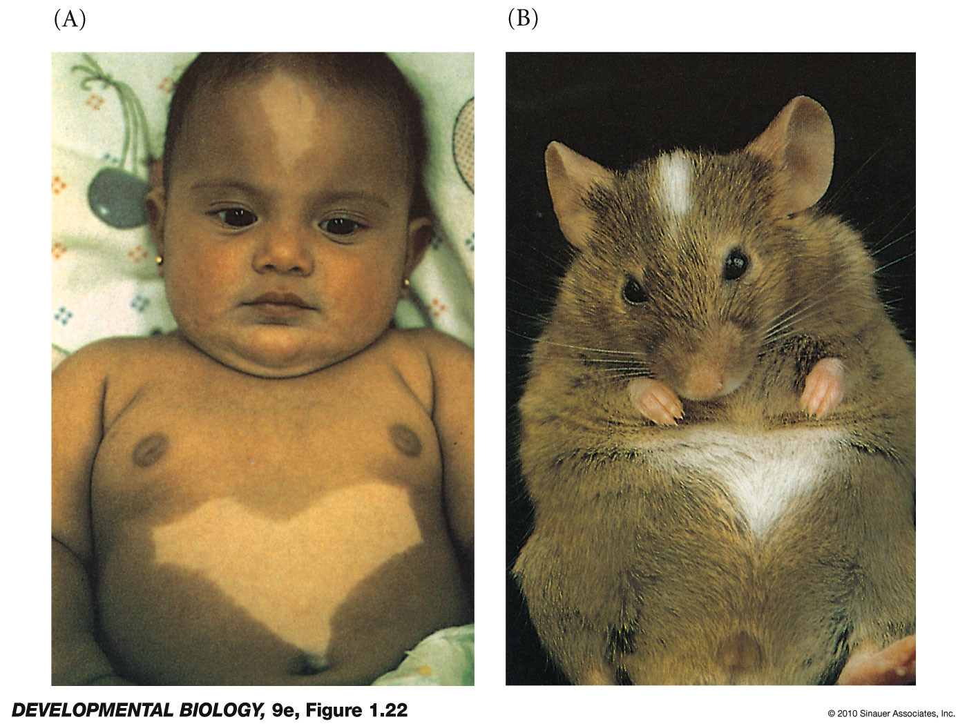
Single gene mutation
How do We Study Single-Gene Defects?
Human syndrome
Mouse model
Piebald
Syndrome:
kit or snail mutation
reduces cell
division in
neural crest
cells.
Notes:
DevBio9e-Fig-01-22-0.jpg

Slide 32
Mitochondrial Defects
Heterogeneous group of disorders that arise from dysfunction of the mitochondrial respiratory chain.
Can be caused by mutations of nuclear or mitochondrial DNA.
A high incidence of mid- and late-pregnancy loss is a common occurrence that often goes unrecognized.

Slide 33
Some affect a single organ (e.g., the eye) but many involve multiple organ systems and often present with prominent neurologic and myopathic features.
CNS Dysfunction Sensory Dysfunction
Encephalopathy External ophthalmoplegia
Seizures Sensorineural deafness
Dementia Optic atrophy
Migraine Retinitis Pigmentosa
Stroke-like episodes
Ataxia
Spasticity
Muscular/CVS Other diseases
Proximal myopathy Diabetes mellitus
Exercise intolerance Epilepsy
Cardiomyopathy

Slide 34
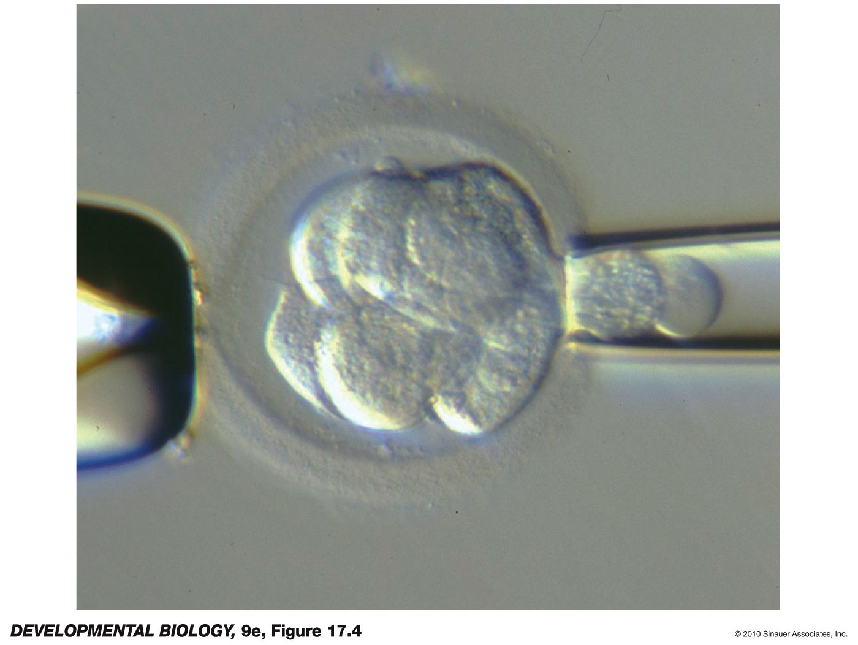
Preimplantation genetics is performed on one or two blastomeres taken from an early blastocyst
Notes:
DevBio9e-Fig-17-04-0.jpg

Slide 35
Multiple Gene-Environment Interactions
Sensitivity to environmental risk factors for a disease are inherited rather than the disease itself being inherited.
Nature versus nurture debates assume variation in a trait is due to either genetic or environmental differences.
Current scientific opinion holds that neither are solely responsible for producing phenotypic variation, and that virtually all traits are influenced by both.
An individual can respond to environmental stimuli, factors or challenges differently according to specific genetic differences or alleles.
These other factors include the diet and specific nutrients within the diet, physical activity, alcohol and tobacco use, sleep (bed time, duration).
And any of a number of exposures (or exposome), including toxins, pollutants, sunlight (latitude north/south of the equator),

Slide 36
Coronary artery disease
Hypertension
Stroke
Myocardial infarction
Cancer
Diabetes
Autism
Non-alcoholic fatty liver disease
Rheumatoid arthritis
Many others…..

